Slide 1
Chapter 2 From Zero to One (part 2)
Suffolk County Community College
CSE 222, Spring 2020

Slide 2
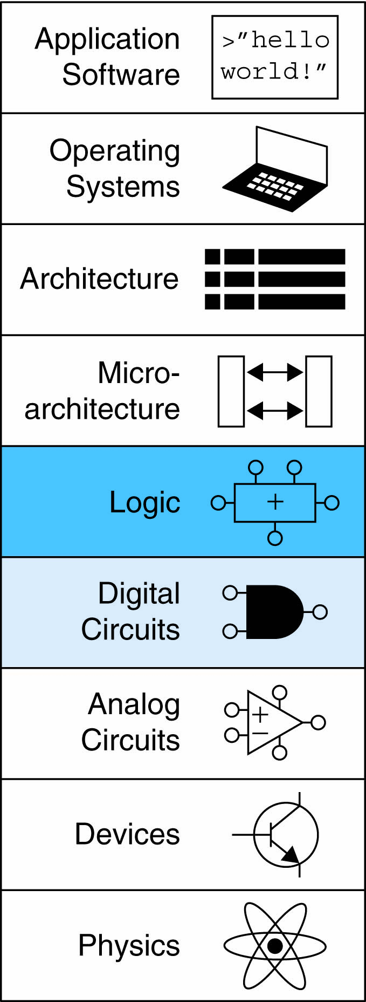
Topics:
Introduction
Boolean Equations
Boolean Algebra
From Logic to Gates
Multilevel Combinational Logic
X’s and Z’s, Oh My
Karnaugh Maps
Combinational Building Blocks
Timing

Slide 3
Simplification of Boolean Equation

Slide 4
Karnaugh Maps (K-Maps)
Boolean expressions can be minimized by combining terms
K-maps minimize equations graphically
PA + PA = P

Slide 5
Karnaugh Maps (K-Maps)
Circle 1’s in adjacent squares
In Boolean expression, include only literals whose true and complement form are not in the circle
Y = AB

Slide 6
3-Input K-Map

Slide 7
3-Input K-Map
Y = AB + BC

Slide 8
K-Map Definitions
Complement: variable with a bar over it
A, B, C
Literal: variable or its complement
A, A, B, B, C, C
Implicant: product of literals
ABC, AC, BC
Prime implicant: implicant corresponding to the largest circle in a K-map

Slide 9
K-Map Rules
Every 1 must be circled at least once
Each circle must span a power of 2 (i.e. 1, 2, 4) squares in each direction
Each circle must be as large as possible
A circle may wrap around the edges
A “don't care” (X) is circled only if it helps minimize the equation

Slide 10
4-Input K-Map

Slide 11
4-Input K-Map

Slide 12
4-Input K-Map

Slide 13
Don’t Care

Slide 14
K-Map With Don’t Cares

Slide 15
K-Map With Don’t Cares

Slide 16
K-Map With Don’t Cares

Slide 17
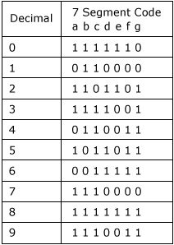
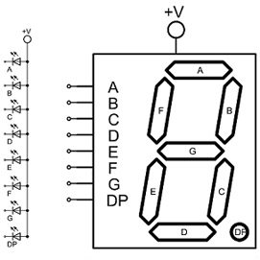
7-Segment Display Decoder

Slide 18
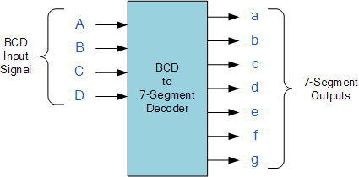
7-segment display decoder

Slide 19
Combinational Building Blocks
Multiplexers
Decoders

Slide 20
Multiplexer (Mux)
Selects between one of N inputs to connect to output
log₂N-bit select input – control input
Example: 2:1 Mux

Slide 21
Multiplexer Implementation
Logic gates
Sum-of-products form
Tristates
For an N-input mux, use N tristates
Turn on exactly one to select the appropriate input

Slide 22
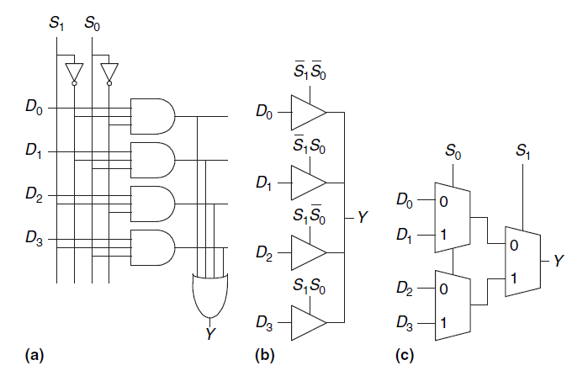
Logic Using Multiplexers
Lookup table

Slide 23
Logic Using Multiplexers
Perform different functions
OR gate ?
XOR gate ?
AND gate

Slide 24
Logic Using Multiplexers
Reducing the size of the mux
? OR: Y = A + B
? XOR

Slide 25
Decoder
N inputs, 2^{N} outputs
One-hot outputs: only one output HIGH at once

Slide 26
Decoder

Slide 27
Logic Using Decoders
OR minterms

Slide 28
Propagation & Contamination Delay
Delay between input change and output changing
How to build fast circuits?

Slide 29
Propagation & Contamination Delay
Propagation delay: t_{pd} = max delay from input to output
Contamination delay: t_{cd} = min delay from input to output

Slide 30
Propagation & Contamination Delay
Delay is caused by
Capacitance and resistance in a circuit
Speed of light limitation
Reasons why t_{pd} and t_{cd} may be different:
Different rising and falling delays
Multiple inputs and outputs, some of which are faster than others
Circuits slow down when hot and speed up when cold

Slide 31
Critical (Long) & Short Paths
Critical (Long) Path: t_{pd} = 2t_{pd_AND} + t_{pd_OR}
Short Path: t_{cd} = t_{cd_AND}

Slide 32
Glitches
When a single input change causes multiple output changes
Example:
What happens when
A = 0, C = 1, B falls?

Slide 33
Glitches

Slide 34
Glitches
Fix:

Slide 35
Understanding Glitches
Glitches don’t cause problems because of synchronous design conventions (Chapter 3)
It’s important to recognize a glitch: in simulations or on oscilloscope
Can’t get rid of all glitches – simultaneous transitions on multiple inputs can also cause glitches

